Slide 1
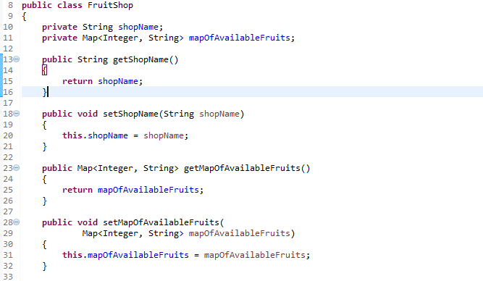
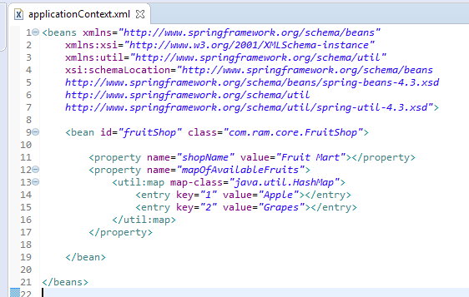
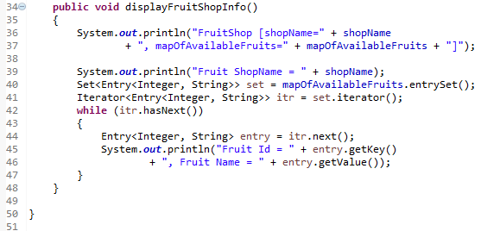
<util:map> to create a concrete Map collection class (HashMap and TreeMap)
We can use <util:map> to create a concrete Map collection class (HashMap and TreeMap) in Spring’s bean configuration file.
< util:map> will instantiate an HashMap at runtime, and inject it into a bean property.

Slide 2
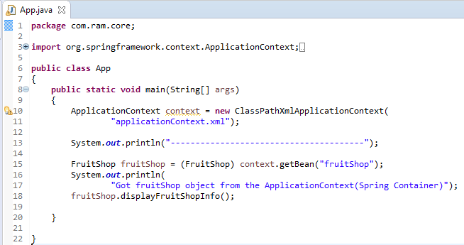
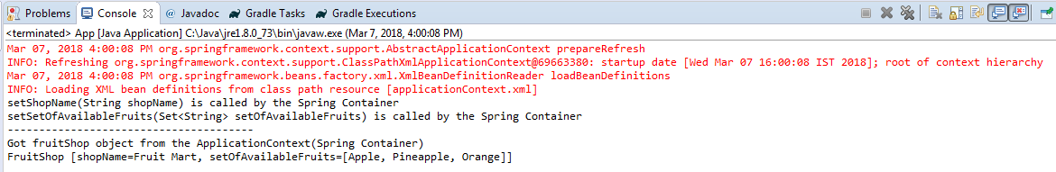
<util:map> to create a concrete Map collection class (HashMap and TreeMap)

